Slide 1
Welcome to something new
Welcome to something new

Slide 2

Welcome to

Slide 3




Slide 4


Slide 5
Software As A Service
A whole business application
Fully supported by vendor
No internal IT resources required
Platform As A Service
A component of a system (e.g. database)
Supported by vendor
Used by IT department to build applications
Infrastructure As A Service
Base infrastructure
Limited vendor support
Skilled IT department needed to make use of it
© 17 Ways Pty Ltd 2015

Slide 6
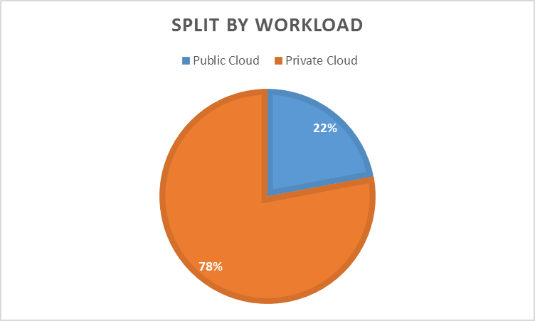
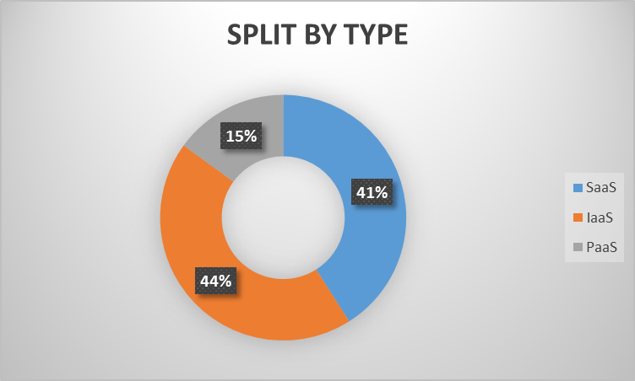
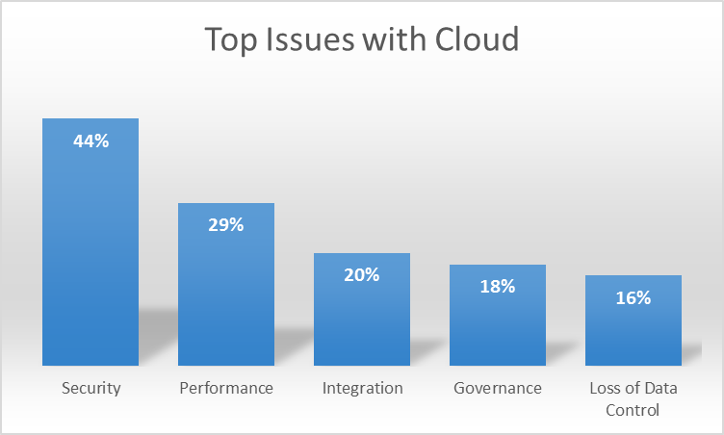
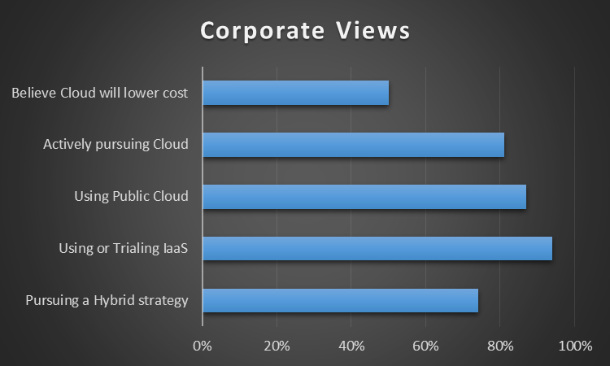
20-25% of IT Budget going into Cloud
$305M spent on Public Cloud by Australian Companies in 2014
© 17 Ways Pty Ltd 2015

Slide 7

Cloud Provider
Other VM
Your VM
Corporate
© 17 Ways Pty Ltd 2015

Slide 8
Corporate
Your VM
© 17 Ways Pty Ltd 2015

Slide 9
Cloud Provider A
Cloud Provider B
Other VM
Other VM
Your VM
Your VM
Corporate
Your VM
© 17 Ways Pty Ltd 2015

